Slide 1

INITIAL REVIEW
Liver Cirrhosis Prediction

Slide 2

Liver Cirrhosis Prediction with XGboost & EDA
Initial Review
2.8.24

Slide 3

Agenda
INTRODUCTION
MODEL
LIBRARIES
DATASET

Slide 4
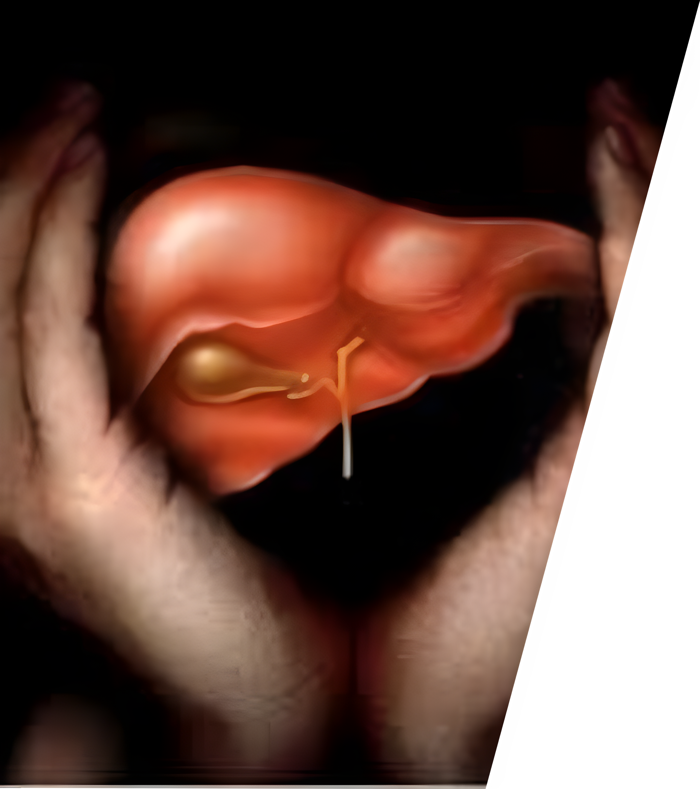
Introduction
LIVER cirrhosis

Slide 5

INTRODUCTION
LIVER CIRRHOSIS
Cirrhosis, also known as liver cirrhosis or hepatic cirrhosis, and end-stage liver disease. Cirrhosis is scarring of the liver and poor liver function. It is the last stage of chronic liver disease

Slide 6
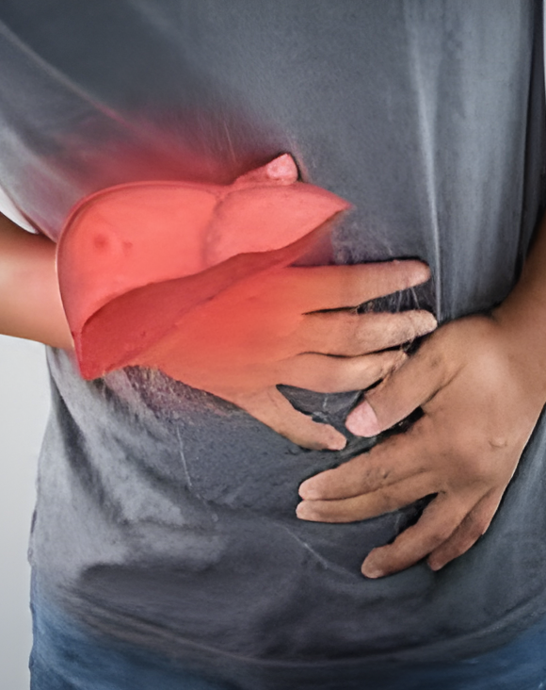
CAUSES
LIVER CIRRHOSIS
Drinking too much alcohol over many years
Being infected with hepatitis for a long time, particularly hepatitis B or hepatitis C
Fat build up in the liver that is not caused by alcohol use, is called Non-Alcoholic Fatty Liver Disease (NAFLD)

Slide 7

Symptoms
LIVER CIRRHOSIS
Loss of appetite
Tiredness
Nausea
Weight loss
Abdominal pain
Spider-like blood vessels
Severe itching

Slide 8

MODEL
XGboost and Stratified K-fold

Slide 9

XGboost
XGBOOST AND STRATIFIED K-FOLD
XGboost is a powerful ensemble learning algorithm for regression and classification tasks.
It sequentially adds weak learners, often decision trees, to correct errors made by existing models using gradient descent optimization.
This iterative approach results in a highly accurate predictive model.

Slide 10

Stratified K-Fold
XGBOOST AND STRATIFIED K-FOLD
Stratified K-Fold Cross-Validation is a variant of K-Fold Cross-Validation crucial for imbalanced datasets, ensuring each fold maintains the same class distribution as the original dataset.
This technique is vital for accurate model assessment, especially when one class is heavily underrepresented.
By preserving class proportions in each fold, it provides a robust evaluation framework for machine learning models.

Slide 11

What are the Libraries used?
Libraries

Slide 12

Numpy
LIBRARIES
Efficient support for numerical operations with N-dimensional arrays.
Rich set of mathematical functions for scientific computing.
Optimized for memory efficiency and high-performance operations.

Slide 13

PANDAS
LIBRARIES
Introduction of key data structures like Series and DataFrame.
Tools for data cleaning, reshaping, and manipulation.
Specialized functionality for time-series data analysis.

Slide 14
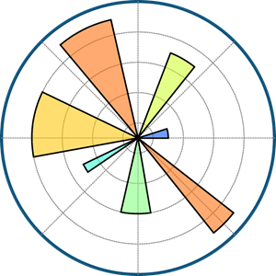
matplotlib
LIBRARIES
Versatile plotting library for static, animated, and interactive visualizations.
Detailed customization options for labels, colors, and styles.
Integration with NumPy and Pandas for comprehensive data visualization.

Slide 15

seaborn
LIBRARIES
Statistical data visualization with automatic styling.
High-level interface for creating aesthetically pleasing plots.
Simplifies the creation of complex visualizations like heatmaps and pair plots.

Slide 16
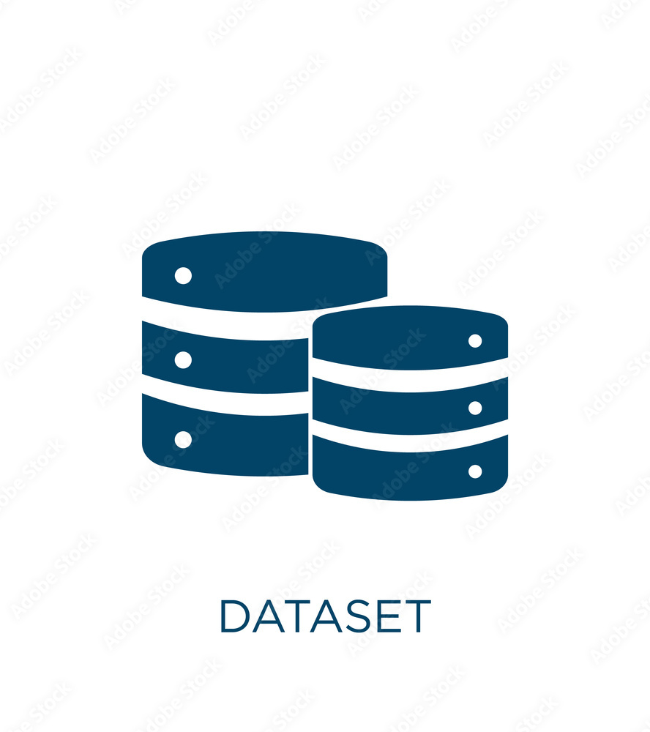
Dataset
ABOUT DATASET

Slide 17

Introduction
ABOUT DATASET
The Mayo Clinic dataset encompasses 424 PBC patients from a 1974-1984 trial, detailed in Fleming and Harrington's "Counting Processes and Survival Analysis." Out of these, 312 participated in a D-penicillamine trial, providing extensive data, while 112 non-trial cases offered additional insights.
Six non-trial cases were lost to follow-up. The trial primarily focused on evaluating D-penicillamine's efficacy in PBC treatment, making the dataset valuable for presentations on liver cirrhosis research.

Slide 18
Column
REGISTRy

Slide 19

What’s next
LOOKING AHEAD

Slide 20
project timeline
R1 |  |  | R2 |  |  | R3 |  |  | R4
 | 8TH FEB |  |  | 22ND FEB |  |  | 11TH MARCH |  |  | 25TH MARCH
Introduction This phase will give you a overview on the project and the dataset that we use. |  |  | Data Management This phase is responsible of missing and preprocessing of data available inside of the dataset. |  |  | Model Management This phase is responsible for model selection and model building of the project which is the heart of the project. |  |  | Error Handling It is responsible for handing the project errors, model errors and data errors. It also responsible for accuracy of the project

Slide 21


Goals for Review 2
LOADING DATA
Exploring dataset
Handling missing values in the dataset
Handling incorrect data types
After data preprocessing, the data is ready for analysis.
Now we have to configure the data which has a significant effect on the outcome of the model and the final result
Now we set up targets and features for final model building

Slide 22



Goals for Review 2
SETTING UP TARGET AND FEATURES
The target variable is what you are trying to predict, and the feature variables are the input variables used for prediction.
DATA PREPROCESSING
a crucial step in preparing your data for machine learning models.
OUTCOME
A refined and well-structured dataset that is ready for use in machine learning models.
By performing the preprocessing steps mentioned earlier, you address common challenges and enhance the quality of the data,
Ultimately contributing to the success of your machine learning model.

Slide 23

SUMMARY
INTRODUCING THE PROJECT
Upon this presentation, we finally understand the project
MODEL OVERVIEW
We have presented the model details that are helpful for the project
LIBRARIES USED
We gave a information about the libraries that we use in this project
DATASET
We have explored the data that we have to work on

Slide 24

THANK YOU

